Slide 1
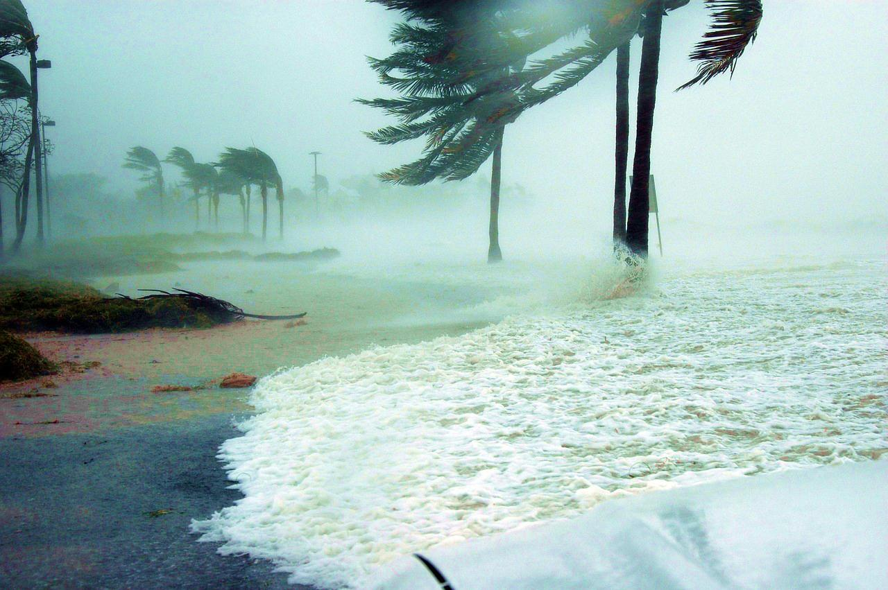
MCSF NOLA HURRICANE
PREPAREDNESS BRIEF
ARE YOU PREPARED?

Slide 2
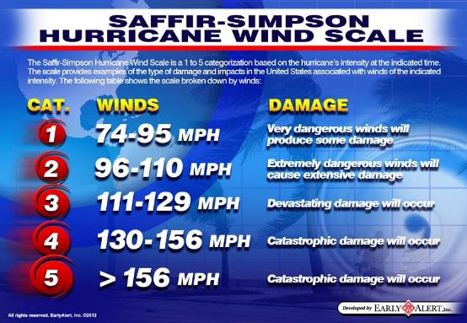
HURRICANES
The North Atlantic hurricane season occurs from June 1 to November 30, sharply peaking from late August through September. Hurricanes are rated by wind intensities based on the Saffir-Simpson scale.

Slide 3
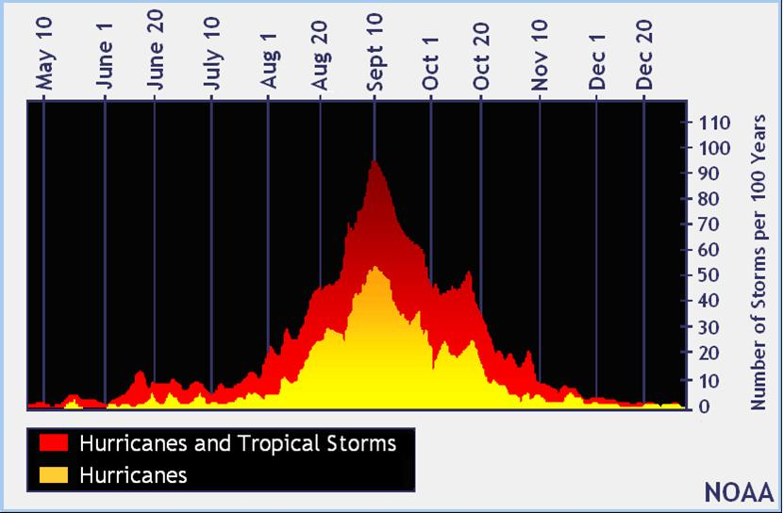

Slide 4
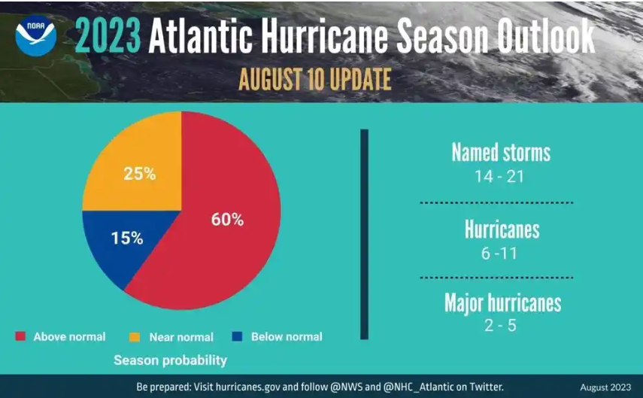
NOAA 2023 Hurricane Season

Slide 5
“Social Mediarologists”
● Just because a forecast goes “viral”
doesn’t mean it’s likely to happen.
● Individual models constantly create
tropical systems.
● There is a 175 mile track error out 5
days. Imagine what that is at 10 days?!
● We will NEVER hide a hurricane from
you!
● NEVER follow someone who is
showing just weather models.

Slide 6
Cone Modeling

Slide 7
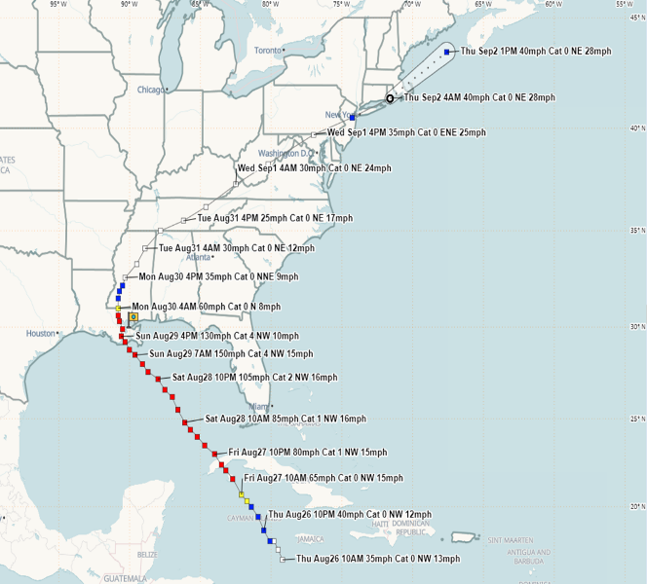
RAPID INTENSIFICATION
Hurricane Ida (2021)
Intensified from a Cat 2 to Cat 4 in nine hours
Forecast major hurricane about 2 days before landfall
Intensified to max strength just prior to landfall
BPT adjust individual plans to account for condensed timelines
Rapid Intensification
(2 Cycles)

Slide 8
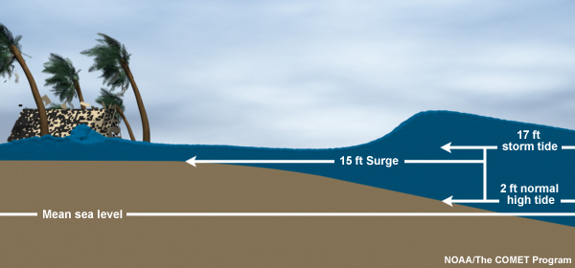
HURRICANES
Additional considerations are:
  Storms speed (in terms of movement)
  Storm surge (inundation)
  Sea state (tides)
  Predicted rainfall (inland flooding)
  Extreme Weather Phenomenon (Tornados, Lightning)

Slide 9
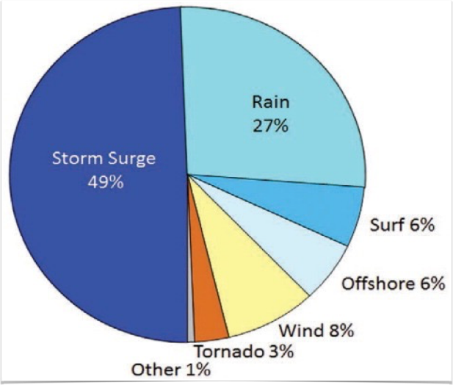
Atlantic Tropical Cyclone Deaths by Hazard
Flooding from storm surge and fresh water (rain) account for over three quarters of deaths directly attributable to Atlantic Basin Tropical Cyclones
88% Water
8% Wind

Slide 10
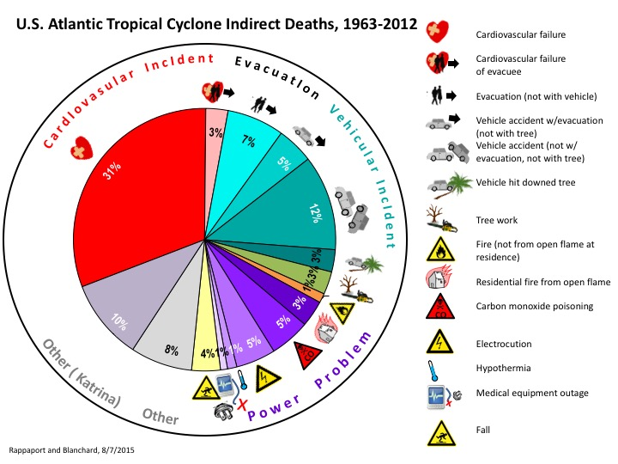
Atlantic Tropical Cyclone Deaths (Indirect) by Hazard

Slide 11
Historically, storm surge is the leading cause of fatalities in tropical systems.
In the last 6 years, we’ve lost more people to carbon monoxide poisoning after a storm than we have to storm surge.

Slide 12
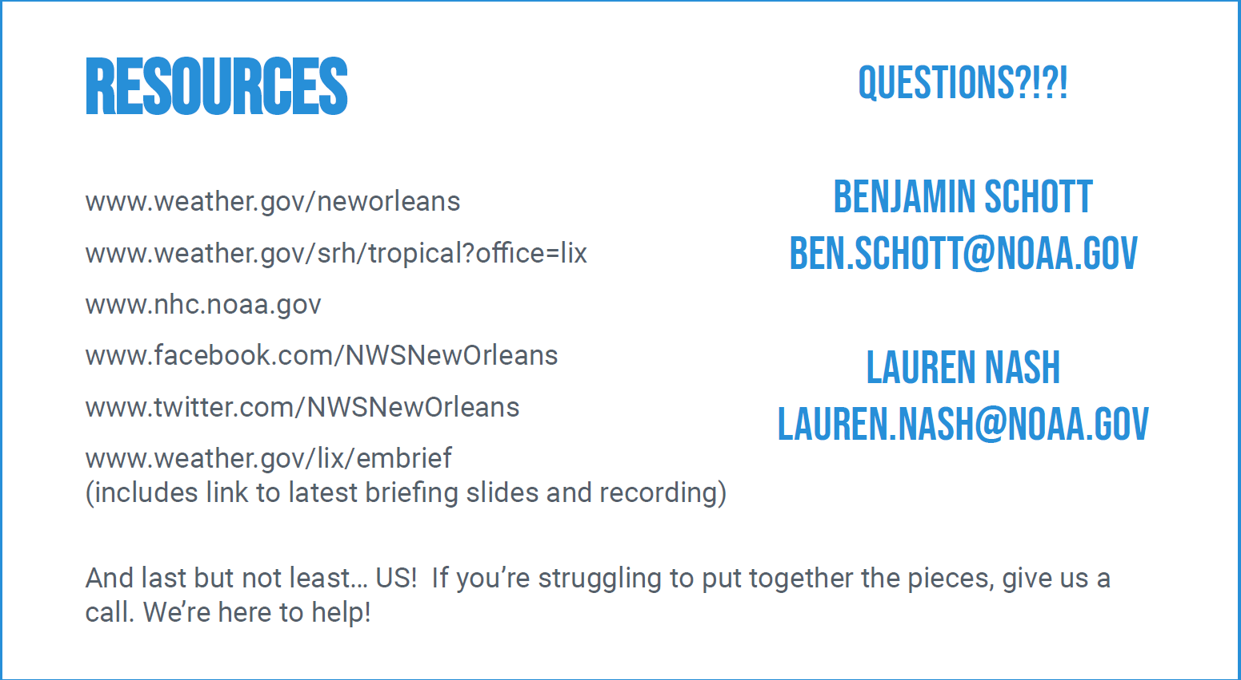
National Weather Service
New Orleans/Baton Rouge

Slide 13
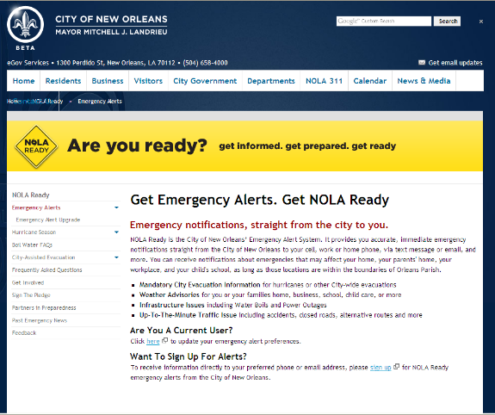
STAY INFORMED
http://www.nola.gov/ready/alert

Slide 14
AtHoc MWNS
AtHoc is the MARCORSPTFAC Mass Warning and Notification System. It is used to alert MARCORSPTFAC personnel of emergency events.
This could be an active shooter, CBRNE/HazMat event, broken water main, destructive weather conditions, etc. Any event needing immediate notification of personnel.
Please ensure your Marines, Sailors, Civilians, and Contractors have an active and UP-TO-DATE profile in AtHoc.
Users can update their profile information at:
https://alerts1.mcdsus.mcds.usmc.mil/SelfService/USMC

Slide 15
Disaster Supply Kit
Rule of 3’s
Air = 3 minutes
Shelter = 3 hours
Water = 3 days
  At least one gallon per person per day for drinking, +2 gallon per person for cooking and hygiene
Food = 3 weeks
  Non-perishable, easy-to-store foods, basic utensils including manual can opener

Slide 16
BEFORE THE STORM
Preparing yourself and your family before the storm arrives is vital to the mission and survival.
www.ready.marines.mil www.getagameplan.org www.ready.gov/plan
Ensure that ALL information in AtHoc is updated
Ensure that you read the message in its entirety and respond
Ensure you have homeowners/ renters insurance with proper coverage
Cash on hand
Important papers are secure
Generator (for emergency electrical power)
Vehicles are topped off with fuel prior to storm arrival
Board up windows
Monitor local news channels, social medial and internet for storm updates
Leave early if possible and preferably during daylight

Slide 17
Disaster Supply Kit: Medical Needs
Copies of prescriptions and 30 day supply
Extra supplies (blood sugar test strips, etc.)
Wheelchairs, canes, respiratory aids, etc.
Names of all medical providers
Copies of health insurance cards
Copy of medical history

Slide 18
Your Disaster Plan
  Evacuation plan
  Communication plan
    Family, friends, employer
  Pet plan
  Re-entry plan

Slide 19

SITUATION
Over 2 million people are at risk in Southeast Louisiana
  1.2 million in New Orleans Metro area alone
Very limited number of evacuation routes from populated areas
Most vulnerable areas need to evacuate first
Hurricane Ivan evacuation in 2004 validated that evacuations must be managed:
  “Gentlemen start your engines!” is not a viable solution

Slide 20

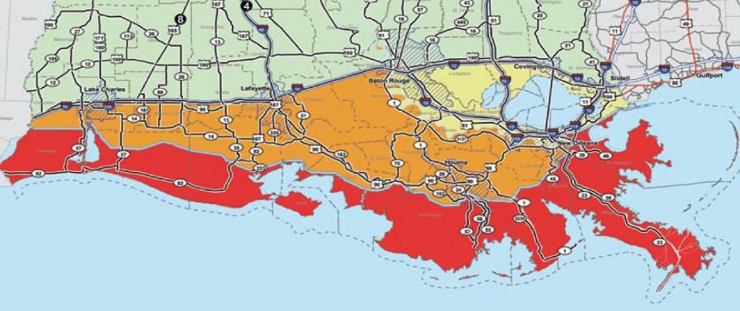
PHASED EVACUATION
(Hours prior to onset of tropical storm force winds)
PHASE I - (H-50 hours) Area south of Intracoastal Waterway, outside of levee protection system, vulnerable to Cat 1 or 2, no route restrictions

Slide 21


PHASED EVACUATION
(Hours prior to onset of tropical storm force winds)
PHASE II - (H-40 hours) Area south of the Mississippi River, levee protected, vulnerable to Cat 2 or higher, suggested routes but no restrictions

Slide 22

PHASED EVACUATION
(Hours prior to onset of tropical storm force winds)
PHASE III - (H-30 hours) Areas on East Bank in the New Orleans Metro area, levee protected, vulnerable to slow Cat 3 or any Cat 4 or Cat 5; Directed Routes (Contraflow)

Slide 23

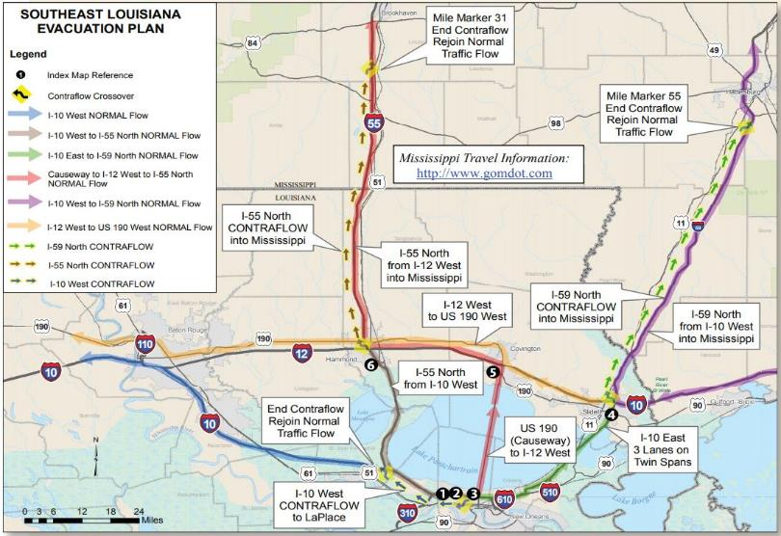
OVERVIEW OF PHASE III
CONTRAFLOW
Source: Louisiana State Police

Slide 24
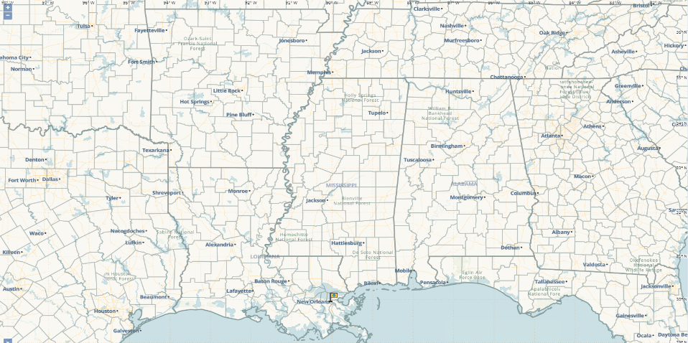
SAFE HAVENS
Evacuations: Minimum of 75 miles – Maximum of 600 miles (based on the Defense Table of Official Distances (DTOD) in Defense Travel System (DTS).
Planning Consideration: Is my safe haven outside of the hazard’s impact area?
https://dtsproweb.defensetravel.osd.mil/dts-app/Distance/view
534mi
397mi
493mi
470mi
540mi
328mi
115mi
147mi
137mi
84mi
93mi
205mi
550mi

Slide 25
Non-Response Team
Actions:
  Upon receipt of evacuation order, MOVE TO SAFE HAVENS.
  Launched approx. at 60 hr. mark (before State Phase I begins)
  Safe havens should be in the traveling direction of the COOP location.
  At safe Havens, await further instructions: to execute Phase III COOP or Phase IV return to NOLA (could be days, weeks, or months depending on damage to infrastructure)

Slide 26
DURING THE STORM
Only stay if you have NOT received authorized evacuation
Do not go out into the storm – Police, Fire and EMS personnel will not be able to rescue you
Understand how to shut off utilities if needed
Fill bathtub with water for hygiene usage
Turn refrigerator to high setting and only open when necessary
Freeze water to keep refrigerator colder longer
Turn off and secure propane tanks

Slide 27
DURING THE STORM
Do not run gasoline powered equipment in confined spaces or indoors
Do not connect a generator to the home’s main power supply unless it has been installed by a professional electrician
Stay away from windows
If near water, stay on the first deck but be prepared to move to the second deck if water rises
Shelter in the interior/center of the structure
Continue to monitor the local news channels, social media and internet if possible

Slide 28
AFTER THE STORM
Continue to monitor local news channels, social media and the internet for updates
Use telephone, including cell, to report life threatening emergencies only
Text messaging may be the best way to communicate
Boil water, prior to drinking or cooking, at a rolling boil for at least one minute
Do not use candle or open flames indoors.

Slide 29
AFTER THE STORM
Be aware of down power lines/poles
Do not return to the area until instructed and safe to do so
Bring food and water back with you because local stores may not be up and running yet
Always carry ID once you’re back in town
Do a full check of your home and property for damage and other hazards
Do not drive into flooded areas, “Turn around, Don’t drown”

Slide 30
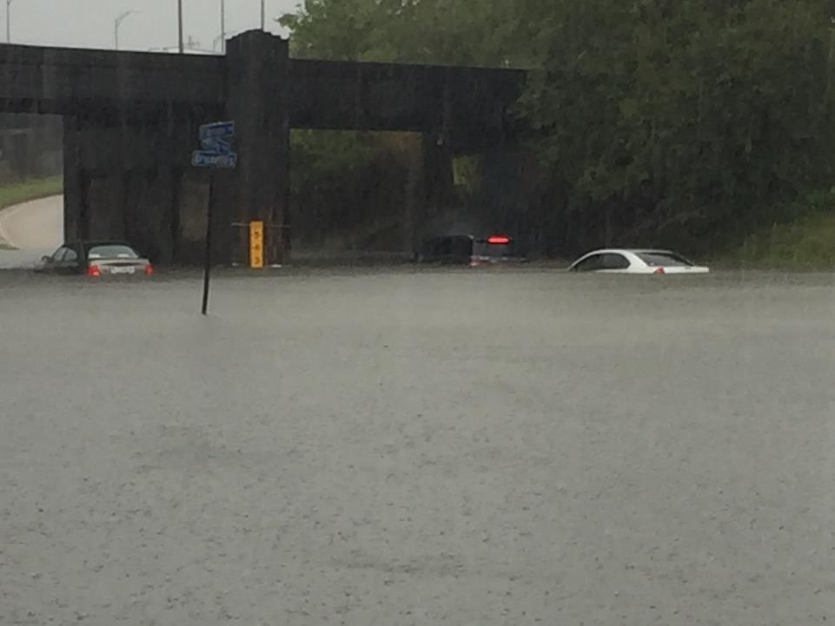
AFTER THE STORM

Slide 31

RE-ENTRY
Tiered Approach
  Tier ER (Color code RED)
    SAR; Fire & EMS; State & Federal LEOs, Homeland Security & Emergency Management; Military
  Tier 1 (Color code BLUE)
    Critical Infrastructure/Utility repair public works public health, water, lighting, transportation and communications; Damage Assessment Teams; Others at discretion of jurisdictions
  Tier 2 (Color code GREEN)
    Relief workers (Red Cross, etc.); Healthcare agencies (including volunteer health professionals; Businesses essential to recovery (Banking, Insurance, etc.)
  Tier 3 (Color code GREY)
    Businesses not included in Tier 2, but are essential to support residents upon return; Residents

Slide 32
FINAL TAKEAWAYS
Plan ahead
  Prepare a Family Readiness Plan (ready.marines.mil or ready.gov)
  Maintain a Disaster Supply Kit
  Stock essentials for at least 72 hours (medications, water, food, etc.)
  Stay aware – watch/listen to local news/weather
  Actions and time needed to prepare residence
Every storm is different, so pay attention to the forecast impacts from each individual storm and try not to draw comparisons to previous storms
Forecasts can change, so pay attention to forecast updates and plan ahead so that you’re prepared in the event conditions look like they may get worse than originally expected.

Slide 33
PET FRIENDLY HOTELS
La Quinta Inn & Suites Fort Worth North
4700 North Freeway
Fort Worth, TX
817-222-2888
La Quinta Inn & Suites Fort Worth Southwest
4900 Bryant Irvin Road
Fort Worth, TX
817-370-2700
MOTEL 6 - Fort Worth West
7960 West Freeway
Fort Worth, TX
817-246-7168
MOTEL 6 - Ft Worth East
1236 Oakland Blvd
Fort Worth, TX
817-834-7361
MOTEL 6 - Fort Worth 3861 Tanacross Dr
Fort Worth, TX
817-834-6700
http://hotels.petswelcome.com

Slide 34
IMPORTANT NUMBERS AND WEBSITES
Marine Corps Forces Reserve 800-638-4698
(www.marforres.marines.mil)
American Red Cross – Southwest Louisiana Chapter 504- 620-3105
(www.redcross.com)
Governor’s Office of Homeland Security and
Emergency Preparedness 225-925-7500
(www.gohsep.la.gov)
Louisiana State Police Road Closure Information 800-469-4828
(www.lsp.gov)
www.511LA.org (DOTD website for road closures)
Marine Corps Police Dept. 504-697-8911
National Hurricane Center (www.nhc.noaa.gov)

Slide 35
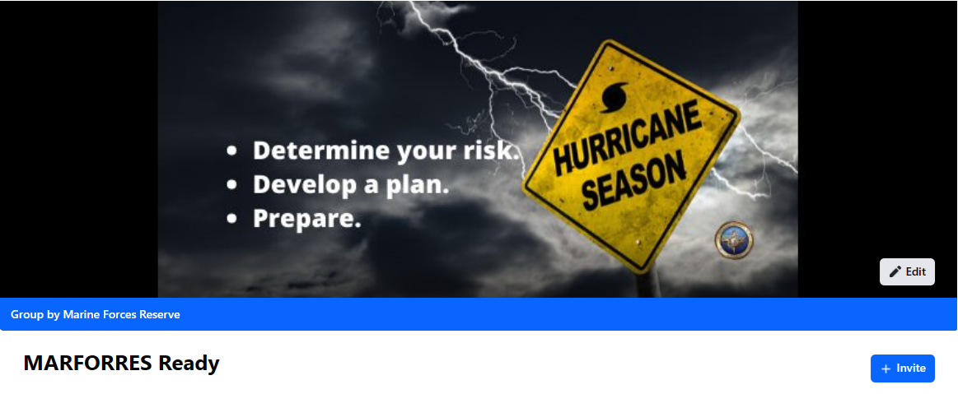
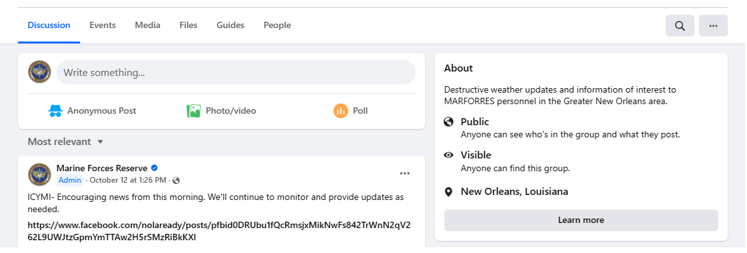
IMPORTANT NUMBERS AND WEBSITES
https://www.facebook.com/groups/marforresready

Slide 36
IMPORTANT NUMBERS AND WEBSITES
National Weather Service New Orleans 985-649-0429
www.weather.gov/neworleans
New Orleans Office of Homeland Security and
Emergency Preparedness 504-658-8700 (www.nola.gov/homeland-security)
MARFORRES Destructive Weather page
http://www.marforres.marines.mil/Family-Resources/Hurricane_Preparedness
MARCORSPTFAC NOLA Destructive Weather page
http://www.marforres.marines.mil/mcsf-nola/Destructive-Weather/
http://www.ready.marines.mil
www.getagameplan.org
Facebook.com/MARFORRES Sub-group MFR NOLA Hurricane Season
Facility Protection Officer 504-697-8032

Slide 37
QUESTIONS

